Slide 1


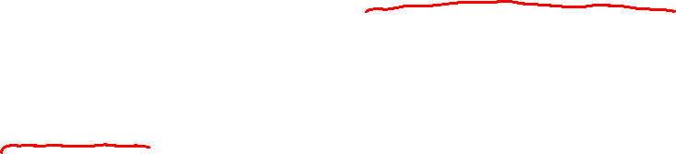
Discrete Fourier Series & Discrete Fourier Transform
Chapter Intended Learning Outcomes
(i) Understanding the relationships between the
transform, discrete-time Fourier transform (DTFT), discrete
Fourier series (DFS) and discrete Fourier transform (DFT)
(ii) Understanding the characteristics and properties of DFS
and DFT
(iii) Ability to perform discrete-time signal conversion
between the time and frequency domains using DFS and
DFT and their inverse transforms
Yuan Chen
Page 1
Semester A 2022-2023

Slide 2







Discrete Fourier Series
DTFT may not be practical for analyzing because
is a function of the continuous frequency variable and we
cannot use a digital computer to calculate a continuum of
functional values
DFS is a frequency analysis tool for periodic infinite-duration
discrete-time signals which is practical because it is discrete
in frequency
The DFS is derived from the Fourier series as follows.
Let be a periodic sequence with fundamental period
where is a positive integer. Analogous to (2.2), we have:
(7.1)
for any integer value of .
Yuan Chen
Page 2
Semester A 2022-2023

Slide 3



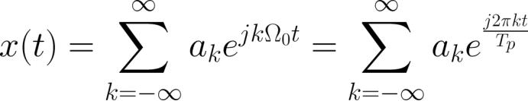




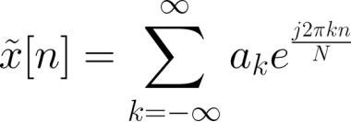
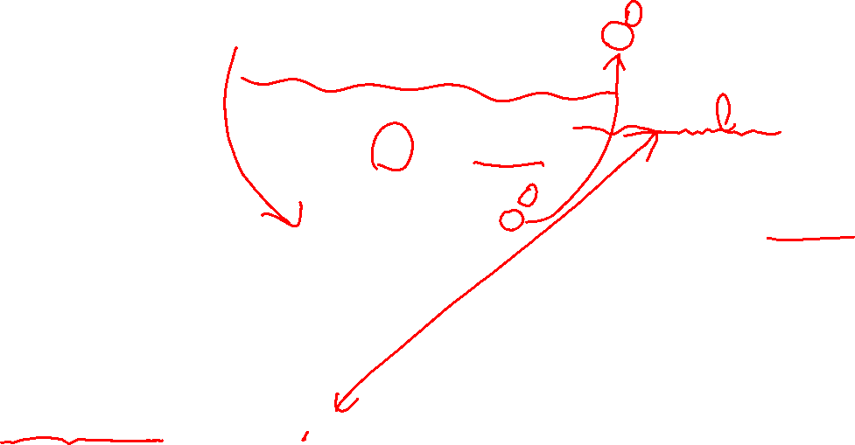
Let
be the continuous-time counterpart of . According
is:
to Fourier series expansion,
(7.2)
.
which has frequency components at
Substituting and
,
:
(7.3)
Note that (7.3) is valid for discrete-time signals as only the
sample points of
are considered.
has frequency components at
and the respective complex
It is seen that
Yuan Chen
Page 3
Semester A 2022-2023

Slide 4

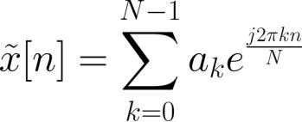


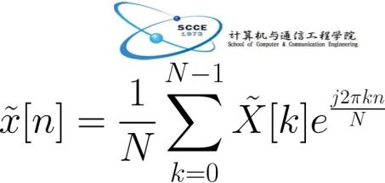
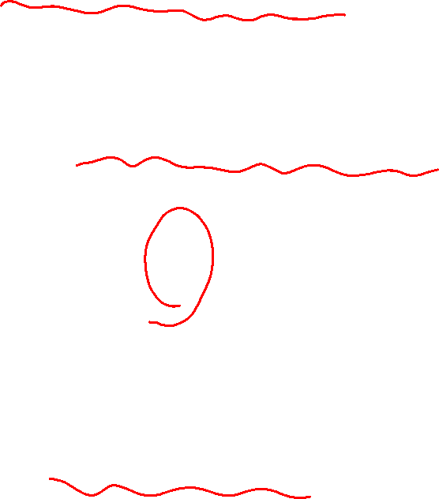
exponentials are
Nevertheless, there are only distinct frequencies in
due to the periodicity of
.
.
Without loss of generality, we select the following distinct
complex exponentials,
, and
thus the infinite summation in (7.3) is reduced to:
(7.4)
Defining
,
, as the DFS
coefficients, the inverse DFS formula is given as:
(7.5)
Yuan Chen
Page 4
Semester A 2022-2023

Slide 5
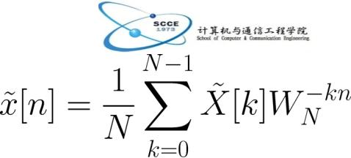





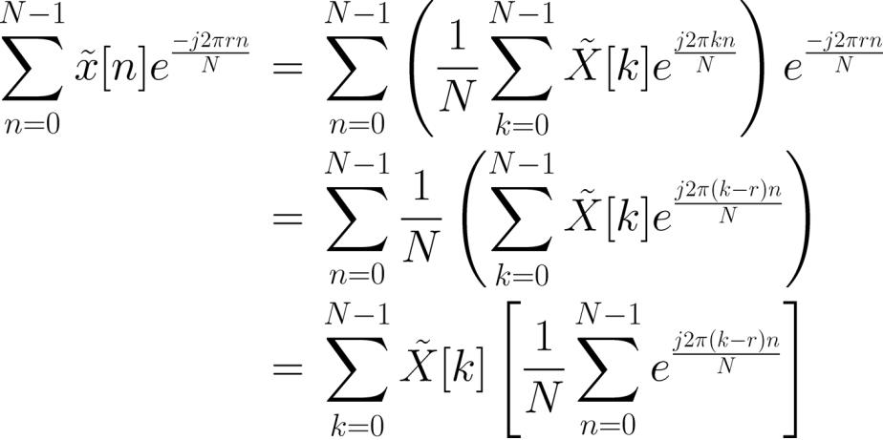
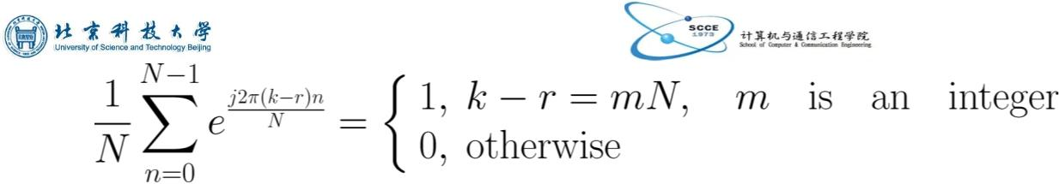
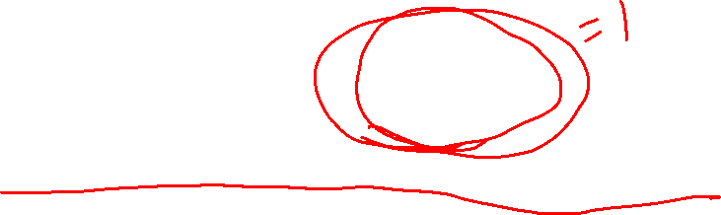
The formula for converting
to
is derived as follows.
and summing
Multiplying both sides of (7.5) by
from to
:
(7.6)
Using the orthogonality identity of complex exponentials:
(7.7)
(7.8)
Yuan Chen
Page 5
Semester A 2022-2023

Slide 6
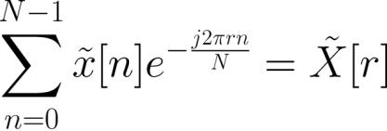


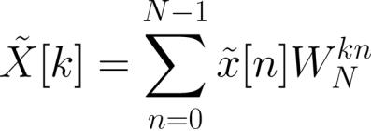

(7.8)
(7.6) is reduced to
which is also periodic with period .
Let
(7.9)
The DFS analysis and synthesis pair can be written as:
(7.10)
and
(7.11)
Yuan Chen
Page 6
Semester A 2022-2023

Slide 7
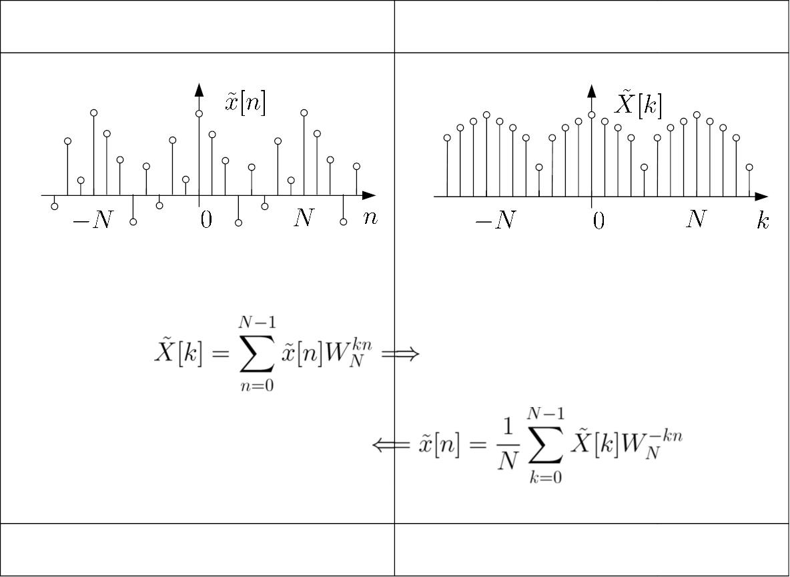
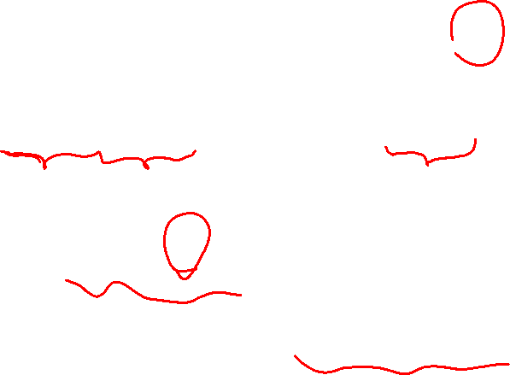
time domain
frequency domain
...
... ...
...
discrete and periodic
discrete and periodic
Fig.7.1: Illustration of DFS
Yuan Chen
Page 7
Semester A 2022-2023

Slide 8

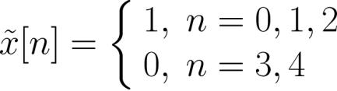
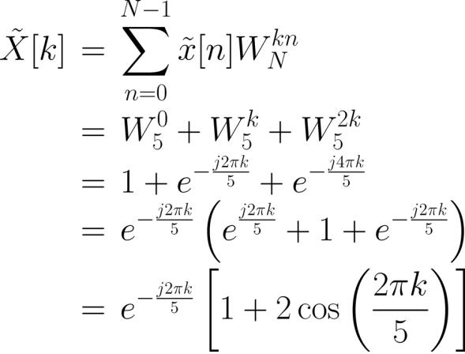
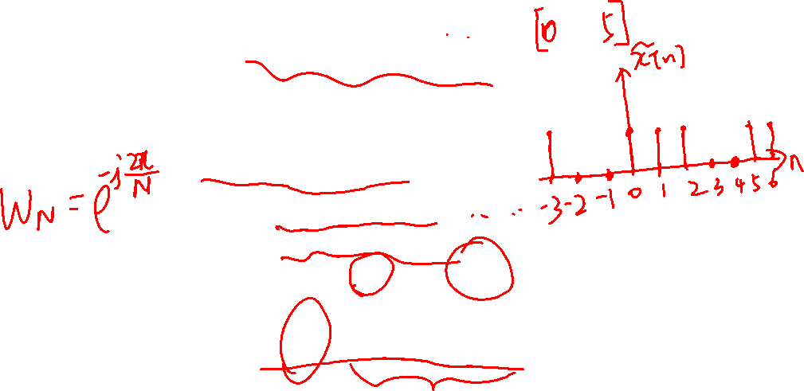
Example 7.1
Find the DFS coefficients of the periodic sequence with a
period of
. Plot the magnitudes and phases of .
Within one period, has the form of:
Using (7.10), we have
Yuan Chen
Page 8
Semester A 2022-2023

Slide 9
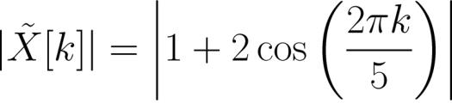
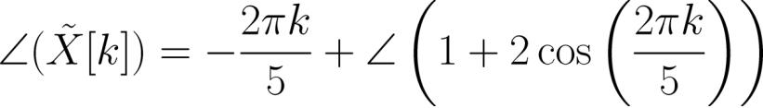
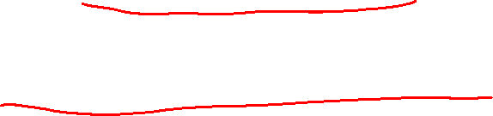
Similar to Example 6.2, we get:
and
The key MATLAB code for plotting DFS coefficients is
N=5;
x=[1 1 1 0 0];
k=-N:2*N;
%plot for 3 periods
Xm=abs(1+2.*cos(2*pi.*k/N));%magnitude computation
Xa=angle(exp(-2*j*pi.*k/5).*(1+2.*cos(2*pi.*k/N)));
%phase computation
Yuan Chen
Page 9
Semester A 2022-2023

Slide 10
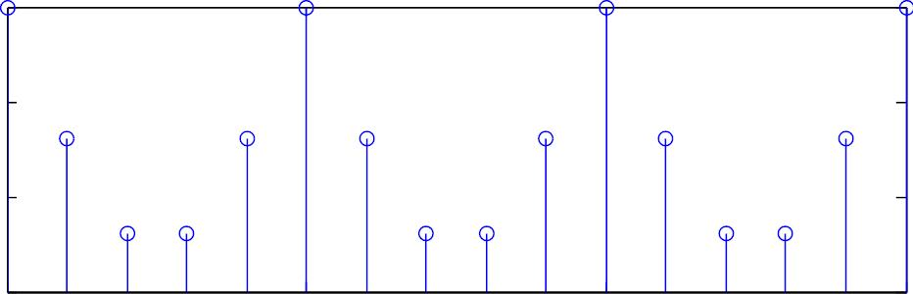
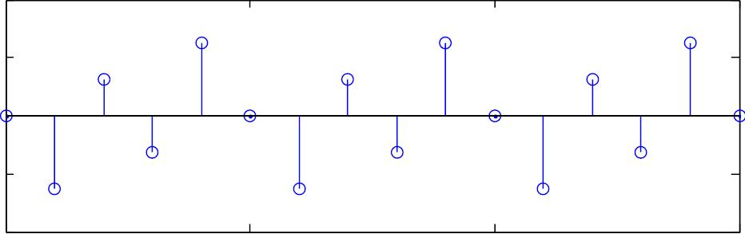
The MATLAB program is provided as ex7_1.m.
Magnitude Response
3
2
1
0
-5
0
5
10
k
Phase Response
2
1
0
-1
-2
-5
0
5
10
k
Fig.7.2: DFS plots
Yuan Chen
Page 10
Semester A 2022-2023

Slide 11
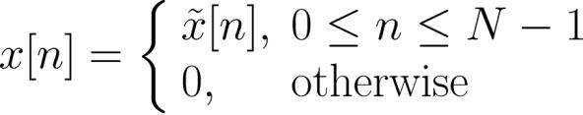

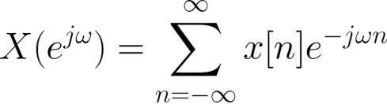

Relationship with DTFT
Let be a finite-duration sequence which is extracted
from a periodic sequence
of period :
(7.12)
(7.13)
Recall (6.1), the DTFT of
is:
With the use of (7.12), (7.13) becomes
Yuan Chen
Page 11
Semester A 2022-2023

Slide 12
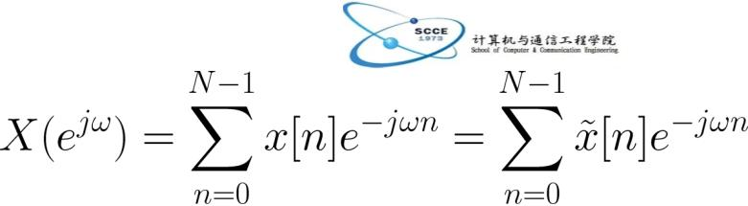






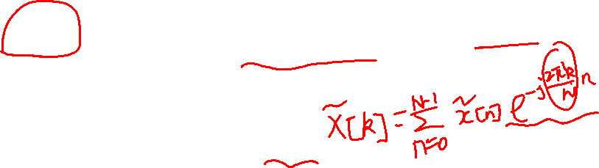
(7.14)
Comparing the DFS and DTFT in (7.8) and (7.14), we have:
(7.15)
That is,
is equal to
sampled at
distinct
frequencies between
with a uniform frequency
spacing of
.
Samples of
or DTFT of a finite-duration sequence
can be computed using the DFS of an infinite-duration
periodic sequence , which is a periodic extension of .
Yuan Chen
Page 12
Semester A 2022-2023

Slide 13









Relationship with z Transform
is also related to transform of
(5.8):
according to
(7.16)
Combining (7.15) and (7.16),
is related to
as:
(7.17)
That is,
is equal to
evaluated at equally-spaced
points on the unit circle, namely,
.
Yuan Chen
Page 13
Semester A 2022-2023

Slide 14
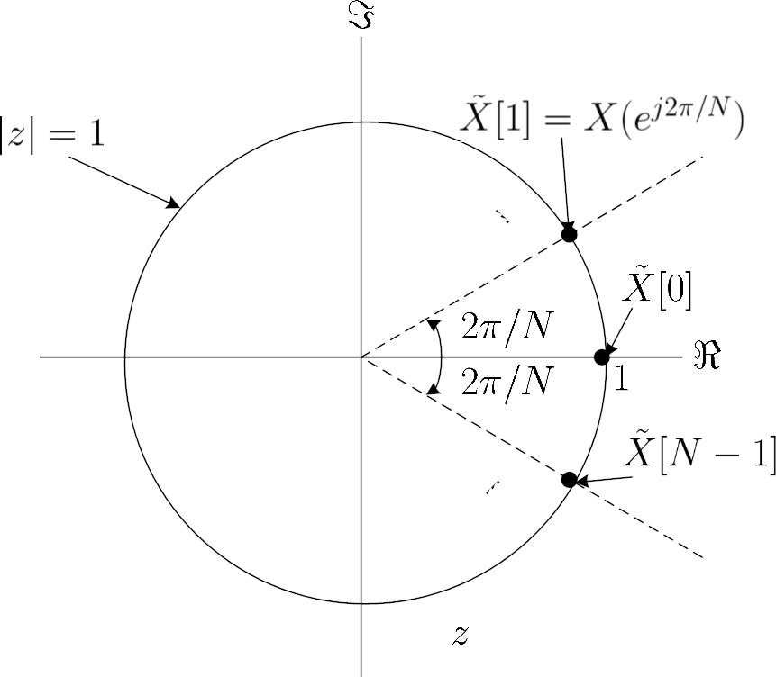



unit circle
-plane
Fig.7.3: Relationship between ,
and
Yuan Chen
Page 14
Semester A 2022-2023

Slide 15
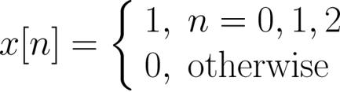
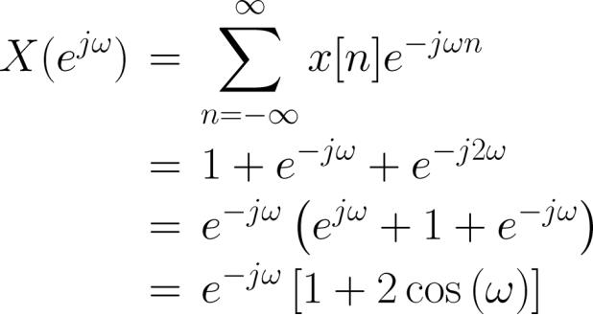
Example 7.2
Determine the DTFT of a finite-duration sequence :
Then compare the results with those in Example 7.1.
Using (6.1), the DTFT of
is computed as:
Yuan Chen
Page 15
Semester A 2022-2023

Slide 16
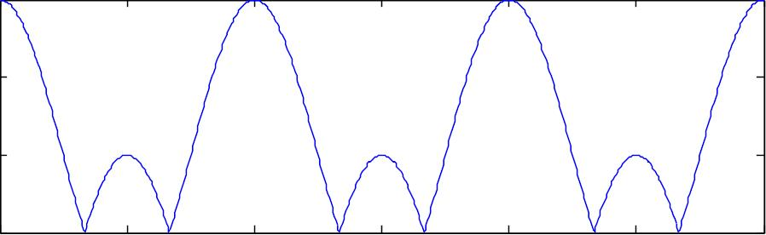
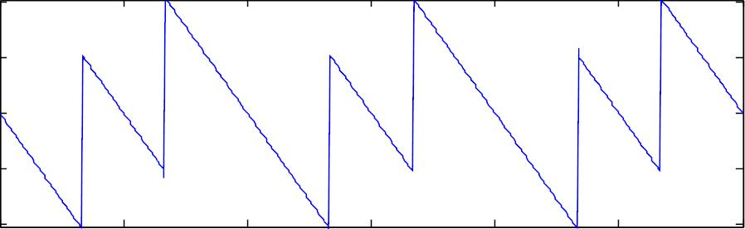
Magnitude Response
3
2
1
0
-2
-1
0
1
/
2
3
4
Phase Response
2
1
0
-1
-2
-2
-1
0
1
2
3
4
/
Fig.7.4: DTFT plots
Yuan Chen
Page 16
Semester A 2022-2023

Slide 17
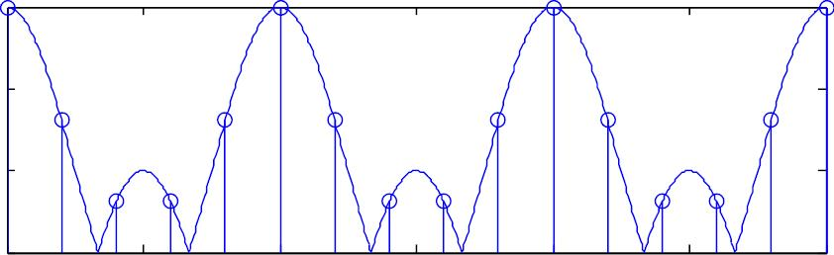
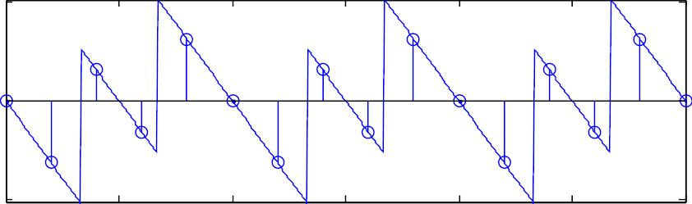
Magnitude Response
3
2
1
0
-2
-1
0
1
/
2
3
4
Phase Response
2
0
-2
-2
-1
0
1
2
3
4
/
Fig.7.5: DFS and DTFT plots with
Yuan Chen
Page 17
Semester A 2022-2023

Slide 18
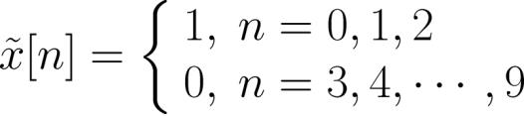

Suppose
in Example 7.1 is modified as:
Via appending 5 zeros in each period, now we have
What is the period of the DFS?
.
What is its relationship with that of Example 7.2?
How about if infinite zeros are appended?
The MATLAB programs are provided as ex7_2.m, ex7_2_2.m
and ex7_2_3.m.
Yuan Chen
Page 18
Semester A 2022-2023

Slide 19
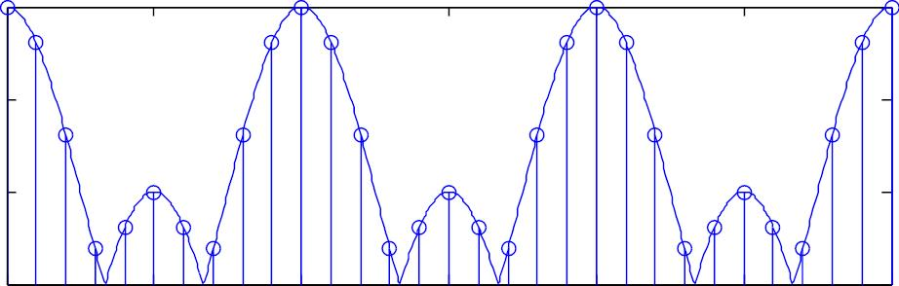
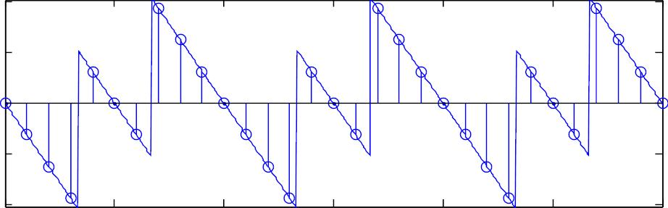
Magnitude Response
3
2
1
0
-2
-1
0
1
/
2
3
4
Phase Response
2
1
0
-1
-2
-2
-1
0
1
2
3
4
/
Fig.7.6: DFS and DTFT plots with
Yuan Chen
Page 19
Semester A 2022-2023

Slide 20

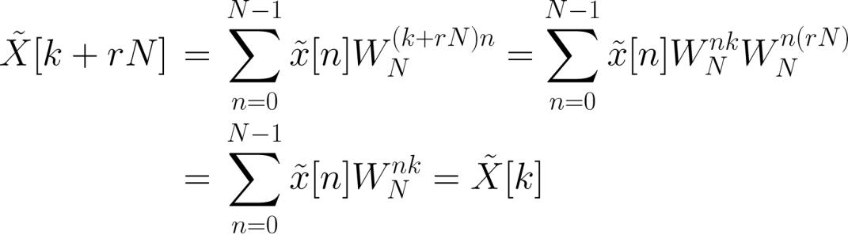
Properties of DFS
1. Periodicity
If
is a periodic sequence with period , its DFS
is
also periodic with period :
(7.18)
where is any integer. The proof is obtained with the use of
(7.10) and
as follows:
(7.19)
Yuan Chen
Page 20
Semester A 2022-2023

Slide 21







2. Linearity
Let
same period of . We have:
and
be two DFS pairs with the
(7.20)
3. Shift of Sequence
If
, then
(7.21)
(7.22)
and
where is the period while and are any integers. Note
that (7.21) follows (6.10) by putting
and (7.22)
follows (6.11) via the substitution of
.
Yuan Chen
Page 21
Semester A 2022-2023

Slide 22




4. Duality
If
, then
(7.23)
5. Symmetry
If
, then
(7.24)
(7.25)
and
Note that (7.24) corresponds to the DTFT conjugation
property in (6.14) while (7.25) is similar to the time
reversal property in (6.15).
Yuan Chen
Page 22
Semester A 2022-2023

Slide 23
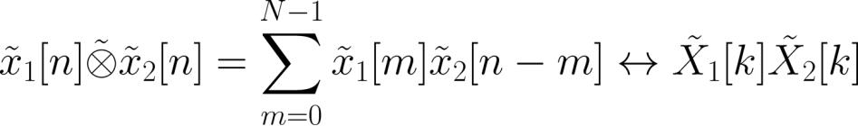

6. Periodic Convolution
Let
and
be two DFS pairs with the
(7.26)
same period of . We have
Analogous to (6.18), denotes discrete-time convolution
within one period.
With the use of (7.11) and (7.21), the proof is given as
follows:
Yuan Chen
Page 23
Semester A 2022-2023

Slide 24
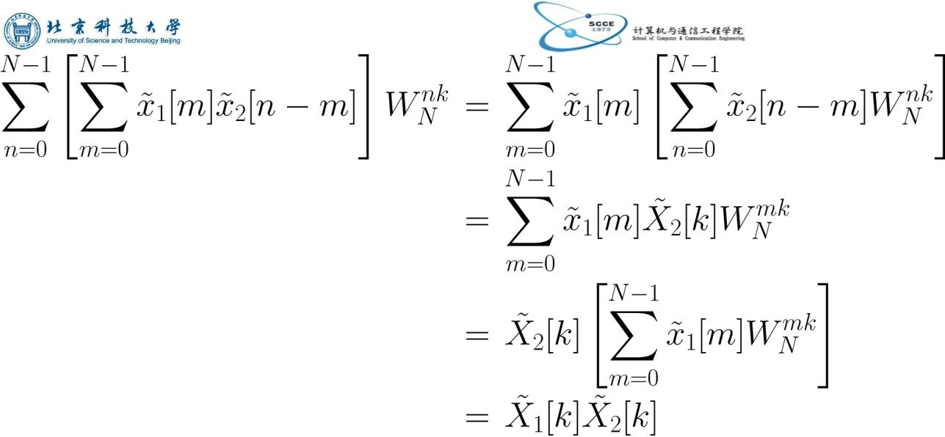



(7.27)
To compute
where both
and are of period ,
we indeed only need the samples with
.
Yuan Chen
Page 24
Semester A 2022-2023

Slide 25

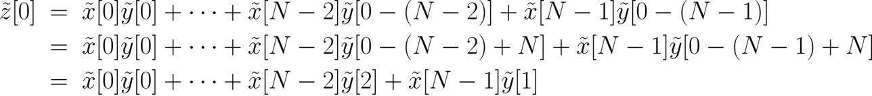

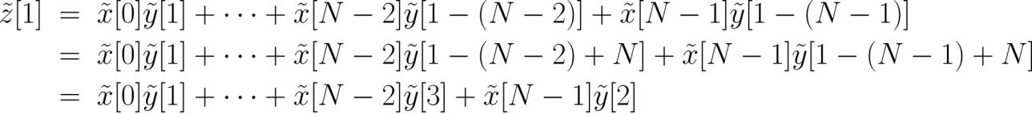
Let
For
. Expanding (7.26), we have:
(7.28)
(7.29)
:
:
For
(7.30)
Yuan Chen
Page 25
Semester A 2022-2023

Slide 26

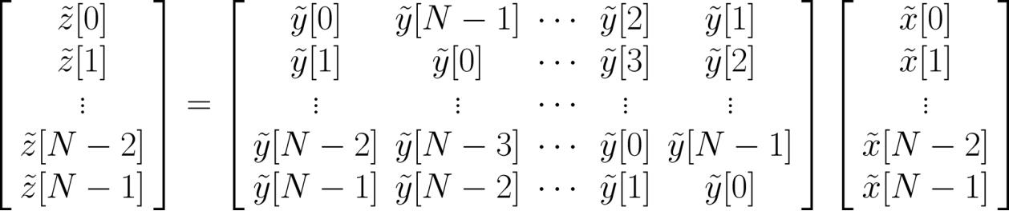

A period of can be computed in matrix form as:
(7.31)
Example 7.3
Given two periodic sequences
and with period :
and
Compute
.
Yuan Chen
Page 26
Semester A 2022-2023

Slide 27
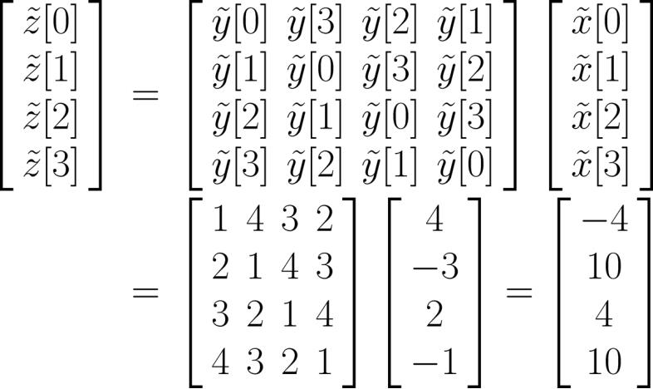
Using (7.31), is computed as:
The square matrix can be determined using the MATLAB
command toeplitz([1,2,3,4],[1,4,3,2]). That is, we
only need to know its first row and first column.
Yuan Chen
Page 27
Semester A 2022-2023

Slide 28















Periodic convolution can be utilized to compute convolution
of finite-duration sequences in (3.17) as follows.
Let
and
be finite-duration sequences with lengths
and , respectively, and
of
which has a length
We append
for constructing periodic
period
and
zeros at the ends of
and
and
where both are of
is then obtained from one period of
.
Example 7.4
Compute the convolution of
periodic convolution. The lengths of
and
and
with the use of
and
are 2 and 3
with
,
,
,
.
Yuan Chen
Page 28
Semester A 2022-2023

Slide 29


The length of
is 4. As a result, we append two
zeros and one zero in and , respectively. According to
(7.31), the MATLAB code is:
toeplitz([1,-4,5,0],[1,0,5,-4])*[2;3;0;0]
which gives
2 -5 -2 15
Note that the command conv([2,3],[1,-4,5]) also
produces the same result.
Yuan Chen
Page 29
Semester A 2022-2023

Slide 30


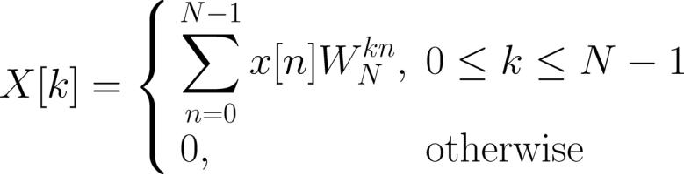
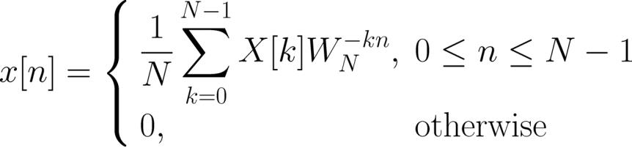
Discrete Fourier Transform
DFT is used for analyzing discrete-time finite-duration
signals in the frequency domain
Let
be a finite-duration sequence of length such that
outside
. The DFT pair of
is:
(7.32)
(7.33)
and
Yuan Chen
Page 30
Semester A 2022-2023

Slide 31




If we extend to a periodic sequence with period ,
the DFS pair for is given by (7.10)-(7.11). Comparing
(7.32) and (7.10),
for
. As a result,
DFT and DFS are equivalent within the interval of
That is, we just extract one period of
construct (7.32) and (7.33).
and
to
As a result, the DFT pair is not well theoretically justified
and we cannot apply (7.32) to produce (7.33) or vice versa
as in DFS, DTFT and Fourier transform.
Yuan Chen
Page 31
Semester A 2022-2023

Slide 32
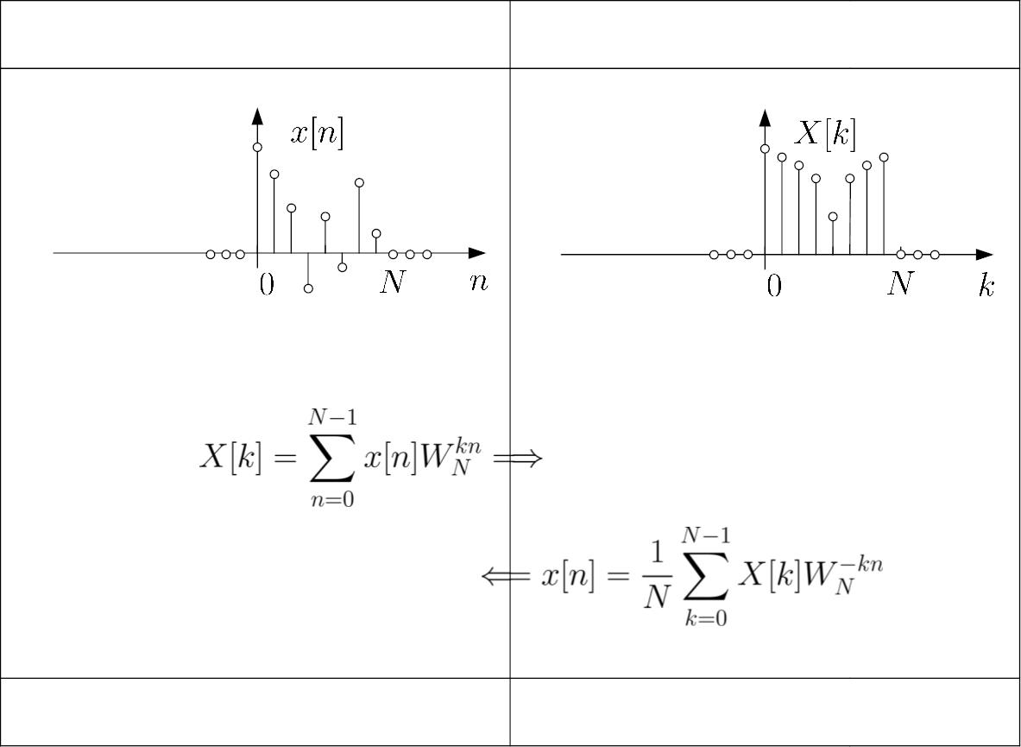
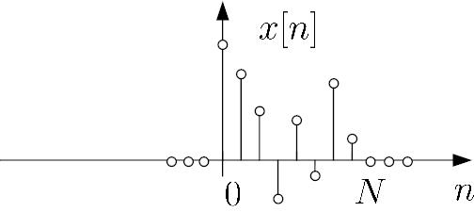
time domain
frequency domain
...
...
...
...
discrete and finite
discrete and finite
Fig.7.7: Illustration of DFT
Yuan Chen
Page 32
Semester A 2022-2023

Slide 33

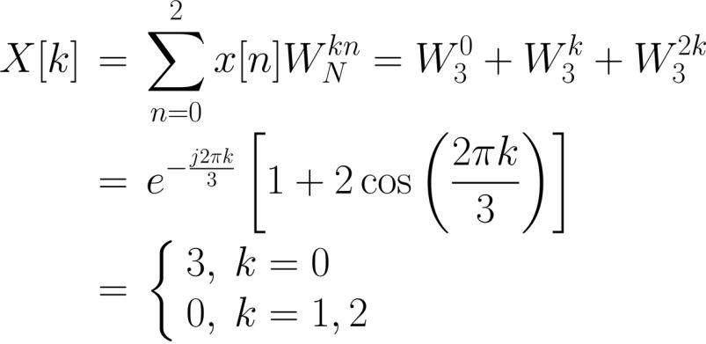
Example 7.5
Find the DFT coefficients of a finite-duration sequence
which has the form of
Using (7.32) and Example 7.1 with
, we have:
Yuan Chen
Page 33
Semester A 2022-2023

Slide 34


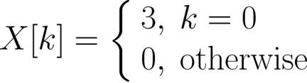


Together with
whose index is outside the interval of
, we finally have:
If the length of
is considered as
such that
, then we obtain:
Yuan Chen
Page 34
Semester A 2022-2023

Slide 35
The MATLAB command for DFT computation is fft. The
MATLAB code to produce magnitudes and phases of
is:
N=5;
x=[1 1 1 0 0];
subplot(2,1,1);
%append 2 zeros
stem([0:N-1],abs(fft(x))); %plot magnitude response
title('Magnitude Response');
subplot(2,1,2);
stem([0:N-1],angle(fft(x)));%plot phase response
title('Phase Response');
According to Example 7.2 and the relationship between DFT
and DFS, the DFT will approach the DTFT when we append
infinite zeros at the end of
Yuan Chen
Page 35
Semester A 2022-2023

Slide 36


The MATLAB program is provided as ex7_5.m.
Magnitude Response
3
2
1
0
0
1
2
3
4
Phase Response
2
1
0
-1
-2
0
1
2
3
4
Fig.7.8: DFT plots with
Yuan Chen
Page 36
Semester A 2022-2023

Slide 37





Example 7.6
Given a discrete-time finite-duration sinusoid:
Estimate the tone frequency using DFT.
Consider the continuous-time case first. According to
(2.16), Fourier transform pair for a complex tone of
frequency is:
That is, can be found by locating the peak of the Fourier
transform. Moreover, a real-valued tone
is:
Yuan Chen
Page 37
Semester A 2022-2023

Slide 38



From the Fourier transform of
from the two impulses.
, and
are located
Analogously, there will be two peaks which correspond to
frequencies
and
in the DFT for .
The MATLAB code is
N=21;
A=2;
w=0.7*pi;
p=1;
%number of samples is 21
%tone amplitude is 2
%frequency is 0.7*pi
%phase is 1
n=0:N-1;
%define a vector of size N
x=A*cos(w*n+p);%generate tone
X=fft(x);
%compute DFT
subplot(2,1,1);
stem(n,abs(X)); %plot magnitude response
subplot(2,1,2);
stem(n,angle(X)); %plot phase response
Yuan Chen
Page 38
Semester A 2022-2023

Slide 39


Magnitude Response
20
15
10
5
0
0
5
10
15
20
Phase Response
2
1
0
-1
-2
0
5
10
15
20
Fig.7.9: DFT plots for a real tone
Yuan Chen
Page 39
Semester A 2022-2023

Slide 40
X =
1.0806
1.0674+0.2939i 1.0243+0.6130i
0.9382+0.9931i 0.7756+1.5027i 0.4409+2.3159i
-0.4524+4.1068i -6.7461+15.1792i 6.5451-7.2043i
3.8608-2.1316i 3.3521-0.5718i 3.3521+0.5718i
3.8608+2.1316i 6.5451+7.2043i -6.7461-15.1792i
-0.4524-4.1068i 0.4409-2.3159i 0.7756-1.5027i
0.9382-0.9931i 1.0243-0.6130i 1.0674-0.2939i
Interestingly, we observe that
and
. In fact, all real-valued sequences
possess these properties so that we only have to compute
around half of the DFT coefficients.
As the DFT coefficients are complex-valued, we search the
frequency according to the magnitude plot.
Yuan Chen
Page 40
Semester A 2022-2023

Slide 41






There are two peaks, one at
which correspond to and
and the other at
, respectively.
From Example 7.2, it is clear that the index refers to
. As a result, an estimate of is:
To improve the accuracy, we append a large number of
zeros to . The MATLAB code for
is now modified as:
x=[A*cos(w.*n+p) zeros(1,1980)];
where 1980 zeros are appended.
Yuan Chen
Page 41
Semester A 2022-2023

Slide 42


Magnitude Response
25
20
15
10
5
0
0
500
1000
1500
2000
Phase Response
4
2
0
-2
-4
0
500
1000
1500
2000
Fig.7.10: DFT plots for a real tone with zero padding
Yuan Chen
Page 42
Semester A 2022-2023

Slide 43




The peak index is found to be
with
. Thus
Example 7.7
Find the inverse DFT coefficients for
which has a length
of
and has the form of
Plot .
Using (7.33) and Example 7.5, we have:
Yuan Chen
Page 43
Semester A 2022-2023

Slide 44

The main MATLAB code is:
N=5;
X=[1 1 1 0 0];
subplot(2,1,1);
stem([0:N-1],abs(ifft(X)));
subplot(2,1,2);
stem([0:N-1],angle(ifft(X)));
Yuan Chen
Page 44
Semester A 2022-2023

Slide 45


Magnitude Response
0.4
0.2
0
0
1
2
3
4
Phase Response
2
1
0
-1
-2
0
1
2
3
4
Fig.7.11: Inverse DFT plots
Yuan Chen
Page 45
Semester A 2022-2023

Slide 46





Properties of DFT
Since DFT pair is equal to DFS pair within
, their
properties will be identical if we take care of the values of
and
1. Linearity
Let
when the indices are outside the interval
and
be two DFT pairs with the
same duration of . We have:
(7.34)
Note that if
and
are of different lengths, we can
properly append zero(s) to the shorter sequence to make them with the same duration.
Yuan Chen
Page 46
Semester A 2022-2023

Slide 47


2. Circular Shift of Sequence
If
, then
(7.35)
Note that in order to make sure that the resultant time
index is within the interval of
which is defined as
, we need circular shift,
(7.36)
where the integer is chosen such that
(7.37)
Yuan Chen
Page 47
Semester A 2022-2023

Slide 48



Example 7.8
Determine
where
is of length 4
and has the form of:
According to (7.36)-(7.37) with
as:
,
is determined
Yuan Chen
Page 48
Semester A 2022-2023

Slide 49

3. Duality
If
, then
(7.38)
4. Symmetry
If
, then
(7.39)
(7.40)
and
Yuan Chen
Page 49
Semester A 2022-2023

Slide 50


5. Circular Convolution
Let
and
be two DFT pairs with the
(7.41)
same duration of . We have
where is the circular convolution operator.
Yuan Chen
Page 50
Semester A 2022-2023

Slide 51



Fast Fourier Transform
FFT is a fast algorithm for DFT and inverse DFT
computation.
Recall (7.32):
(7.42)
Each
involves and
complex multiplications and
additions, respectively.
Computing all DFT coefficients requires
complex
multiplications and
complex additions.
Yuan Chen
Page 51
Semester A 2022-2023

Slide 52



Assuming that
requirements for FFT are
and complex additions.
, the corresponding computational
complex multiplications
Table 7.1: Complexities of direct DFT computation and FFT
Yuan Chen
Page 52
Semester A 2022-2023

Slide 53




Basically, FFT makes use of two ideas in its development:
. Decompose the DFT computation of a sequence into
successively smaller DFTs
. Utilize two properties of
:
.complex conjugate symmetry property:
(7.43)
.periodicity in and :
(7.44)
Yuan Chen
Page 53
Semester A 2022-2023

Slide 54




Decimation-in-Time Algorithm
The basic idea is to compute (7.42) according to
(7.45)
Substituting
and
for the first and second
summation terms:
(7.46)
Yuan Chen
Page 54
Semester A 2022-2023

Slide 55







Using
since
, we have:
(7.47)
where
and
are the DFTs of the even-index and odd-
index elements of , respectively. That is,
can be
constructed from two -point DFTs, namely,
and .
Further simplifications can be achieved by writing the
equations as 2 groups of
equations as follows:
(7.48)
Yuan Chen
Page 55
Semester A 2022-2023

Slide 56





and
(7.49)
with the use of
and
. Equations (7.48) and
(7.49) are known as the butterfly merging equations.
Noting that multiplications are also needed to calculate
, the number of multiplications is reduced from to
.
Yuan Chen
Page 56
Semester A 2022-2023

Slide 57




Decimation-in-Frequency Algorithm
The basic idea is to decompose the frequency-domain
sequence
into successively smaller subsequences.
Recall (7.42) and employing
and
, the even-index DFT coefficients are:
(7.50)
Using
and
, the odd-index coefficients are:
Yuan Chen
Page 57
Semester A 2022-2023

Slide 58





(7.51)
and
are equal to
-point DFTs of
and
, respectively. The
decomposition step of (7.50)-(7.51) is repeated times
until 1-point DFT is reached
Yuan Chen
Page 58
Semester A 2022-2023

Slide 59
Fast Convolution with FFT
The convolution of two finite-duration sequences
y[n]  x [n] x [n]
1
2
where x [n] is of length N and x [n] is of length N requires
1
1
2
2
computation of (N +N -1) samples which corresponds to
1
2
N N  minN , N  complex multiplications
1 2
1
2
An alternate approach is to use FFT:
y[n]  IFFTFFT{x [n]} FFT{x [n]}
1
2
In practice:
. Choose the minimum N  N  N 1 and is power of 2
1
2


. Zero-pad x [n] and x [n] to length N , say, x [n] and x [n]
1
2
1
2



. y[n]  IFFTFFT{x [n]} FFT{x [n]}
From (7.33), the inverse DFT has a factor of 1/ N , the IFFT
1
2
Yuan Chen
Page 59
Semester A 2022-2023

Slide 60

thus requires N  (N / 2) log (N) multiplications. As a result,
2

the total multiplications for y[n] is 2N  (3N / 2) log (N)
2
Using FFT is more computationally efficient than direct
convolution computation for longer data lengths:
N₁
N₂
N
N N  minN , N  2N  (3N / 2) log (N)
1 2
1
2
2
2
5
8
8
52
10
50
15
80 256
32
140
3950
49950
304
3584
37888
50 1000 2048
512 10000 16384
4119488
376832
MATLAB and C source codes for FFT can be found at:
http://www.ece.rutgers.edu/~orfanidi/intro2sp/#progs
Yuan Chen
Page 60
Semester A 2022-2023

